Slide 1

Welcome
DevOps
Notes:
Mandatory
ACTION: Adjust title to fit your course.

Slide 2
Prerequisites
This course assumes you:
Are interested in learning more about the theory behind DevOps & DevSecOps

Slide 3
Why study this subject?
Modern software engineering requires a new approach
This approach should include automation wherever possible
That automation should also cover security of the environments & build strategy

Slide 4
My pledge to you
I will...
Make this interactive
Ask you questions
Ensure everyone can speak
Use an on-screen timer

Slide 5
Objectives
At the end of this course you will be able to:
Speak high-level to the importance of DevOps and “shifting security left” in modern software engineering

Slide 6
Agenda
What a difference 45 minutes can make!!
DevOps – What it is & why it’s valuable
Twelve Factor Apps
Infrastructure-as-Code (IaC)

Slide 7
What a difference 45 minutes can make!!

Slide 8


How Long Does it Take for a Company to Go Bankrupt?
If the circumstances are right, it can happen in just 45 minutes!
Notes:
We’re going to talk about an (albeit extreme) example of what can go wrong in the deployment of new software and how lack of DevSecOps practices at one company (Knight Capital Group) resulted in a $460M loss in just 45 minutes.

Slide 9











Knight Capital Group – What Happened?
Automated Stock
Trading System
Receives Large
Trading Orders
(“Parents”)
Automates Breakup
into Smaller
“Child” Orders
Manual
Deployment to
Eight Servers
New Functionality
Thoroughly Tested
Repurposed Old
Code to Implement
Trading Starts
(9:30 a.m.)
One Server Missed
(Human Error)
Serious Problem
Experienced Live
10:15 a.m.
Tried Frantically
to Fix
Missed Server Not
Bounding “Child” Orders
Against “Parent” Size
$460M loss vs. $365M in assets!
Source: https://dougseven.com/2014/04/17/knightmare-a-devops-cautionary-tale/
Notes:
Talk through the details of the specific scenario
For tried frantically to fix – no good observability/messaging for troubleshooting; assuming issue with new code, rolled back all new code which left the 7 “good” servers with the same problem as the 1 “bad” one.

Slide 10

Moment of Reflection
From the brief overview of the Knight Capital Group scenario, can you identify any specific implementation choices that might’ve led to the issues encountered?
Type your answer in chat or come off mute and share

Slide 11

So, What Went Wrong?
Repurpose of legacy code and legacy flags/variables without proper quality checks
Fully manual deployment
No “kill switch” and no clear path to rollback
Insufficient observability and monitoring to alert resources to issues
Forced to test and troubleshoot live in Production
Notes:
Deployment and validation is SLOW
Quality confirmed in isolated environment but unable to validate in Production-like environment
Can’t get the information needed live to troubleshoot and fix
Can’t respond quickly enough to isolate issues
Forced to test and troubleshoot live in Production – damage is already done!!!

Slide 12
DevOps – What it is & why it’s valuable

Slide 13


Approach Used In the “Olden” Times
#$@&%*!!!
Development
Operations
#$@&%*!!!
Development & Operations siloes
Lack of understanding of the other perspective
Lack of communication & partnership
“Fire and forget” engagement

Slide 14


DevOps – The New Way
Development
Operations
Development & Operations work together
Each understands & appreciates the position of the other
Good communication, partnership, & collaboration
Ongoing engagement – continuous improvement

Slide 15
DevOps – The Three Ways
The First Way: Flow/Systems Thinking
Business
Customer
Source: Gene Kim (https://itrevolution.com/the-three-ways-principles-underpinning-devops/)
Development
Operations
Holistic vs. siloed view – success is defined by the performance of the entire system vs. a specific team or individual
Starts with requirements (defined by the business) and not called “done” until value is delivered to the customer
Target outcomes:
Known defect never passed to downstream teams
Favor global performance vs. focusing on local optimization
Goal is increased flow (value)
Asking ourselves the question: “What don’t I know about our systems?”

Slide 16
DevOps – The Three Ways
The Second Way: Amplify Feedback Loops
Source: Gene Kim (https://itrevolution.com/the-three-ways-principles-underpinning-devops/)
Development
Operations
Create right-to-left feedback loops
Shorten & amplify so information needed to make continuous improvements & continuous correction is readily available
Target outcomes:
Understanding all customer perspectives (internal & external)
Responding to all customer concerns (internal & external)
Knowledge is power!

Slide 17

DevOps – The Three Ways
The Third Way: Culture of Continual Experimentation & Learning
Source: Gene Kim (https://itrevolution.com/the-three-ways-principles-underpinning-devops/)
Development
Operations
Culture that fosters:
Continual experimentation, risk-taking, and learning from failure
Practice makes perfect!
Target outcomes:
Allocating time for continual improvement (e.g., resolution of technical debt as a standard “category” of work)
Taking risks and seeing them pay off – No guts no glory!
Expecting failure & building resiliency into the process
Notes:
Risk aren’t bad – reckless risks are

Slide 18
DevSecOps and how businesses can benefit from it
DevSecOps integrates software development with IT/SEC operations, leveraging automation to shorten the product life-cycle and enable frequent deliveries aligned with the business needs, while ensuring quality
DevSecOps Building Blocks
Impact Levers
Continuous integration
Automated testing and single source code mgmt. system
Speed
Release in days, not months
Continuous delivery
Ability to deliver software when ready
Quality
Enable speed and enhance stability with rigor and confidence
Continuous deployment
One-click release of software to live
Continuous monitoring and autonomic operations
Highly automated IT Operations, including security, vulnerability scanning
Efficiency
Operate in automated environment and focus on high value tasks
Standardized and automated infrastructure mgmt. with built in security
Automate environment with infrastructure-as-a-code (IaC),
Security
Baked-in and fully integrated into SDLC

Slide 19
Building Blocks & Knight Capital Group
Software remains in a “ready to release” state enabling agility
Copious and effective monitoring alerts us to problems quickly so we can respond quickly
Continuous Delivery
Continuous Monitoring
Continuous Integration
Continuous Deployment
Automated Infrastructure
Automated testing finds issues quickly and helps ensure quality/reduce fear when releasing
Automated release at the “push of a button” reduces element of human error
Automated build out of secure runtime environments (and ability to quickly roll back in the event of a discovered issue) drives stability
Notes:
How could DevSecOps have helped in the scenario discussed here?
Continuous Integration – Sounds like KCG did a relatively decent job of testing but automation helps verify quality at scale

Slide 20
Balancing Speed & Quality
Let’s briefly drilldown into security – the “Sec” in “DevSecOps”
Speed
Regulatory Compliance
Business Agility
Security
Quality
We want to move quickly to maintain a competitive advantage & increase profitability
We want to move safely to ensure we minimize rework cost & prevent monetary & reputational damage
Notes:
Talking point – DevSecOps as a mechanism for achieving this balance

Slide 21

Security in Software Engineering – The Traditional Way
Not enough time in schedule to absorb changes required to remediate
Activities required to remediate may be complex
Security issues require revisit of one or more previous phases
Release
Plan
Operate
Test
Develop
Feedback

Slide 22
Security in Software Engineering – A Better Way
Release
Plan
Operate
Test
Develop
Feedback

Slide 23
Security in Software Engineering – DevSecOps
Additional security-specific scanning, port scans, and log validation
Threat modeling, data protection, and risk assessment
Release
Plan
Operate
Test
Develop
Monitoring & alerting, RCA (Root Cause Analysis)
Feedback
SAST (Static Application Security Testing) and SCA (Software Composition Analysis) tooling
DAST (Dynamic Application Security Testing) tooling

Slide 24

Security in Software Engineering – DevSecOps
Information gathered from early phases feed into later phases
In true DevOps fashion, lessons learned feed continuous improvement
Release
Plan
Operate
Test
Develop
Feedback
Quality gates guard against moving security defects forward

Slide 25
POLL
In which phase of the SDLC is it easiest to find and fix a bug? Plan, Develop, Test, Deploy, Operate

Slide 26
POLL
In which phase of the SDLC is it cheapest to find and fix a bug? Plan, Develop, Test, Deploy, Operate

Slide 27
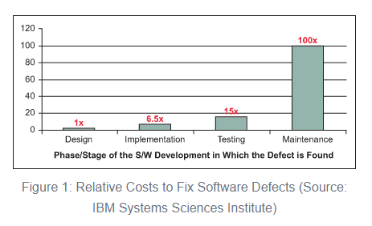
Relative Cost for Finding & Fixing Bugs
Bottom line? The sooner, the cheaper!
Source: https://www.isixsigma.com/tools-templates/software/defect-prevention-reducing-costs-and-enhancing-quality/
27

Slide 28

Shifting Security Left – Develop
Ideally, security flaws in code would be caught on a developer’s machine
Can use plugins for IDEs to provide automated static analysis
In some cases, tools can be configured with custom rules and priorities

Slide 29
Shifting Security Left – Develop
Rulesets and priorities should be driven by results of threat modeling
Scanning tools if used should be a standard part of all developer’s code tooling, to ensure consistently applied (standard dev build)
Goal is to catch issues VERY early on in the SDLC

Slide 30
Moment of Reflection
What is the most “secure” programming language in use in the industry today?
Type your answer in chat
Notes:
https://www.whitesourcesoftware.com/most-secure-programming-languages/

Slide 31
Shifting Security Left – Build
Changes from a developer are ready to be integrated with others
Typically driven through submission of Pull Request in GitHub
Notifies a peer that changes are pending and need review

Slide 32
Shifting Security Left – Build
In addition to logic/syntax errors, peer reviewer can focus on areas of high risk/high impact identified in threat modeling
In some cases, a specialist peer reviewer (e.g., one from InfoSec) can be engaged to validate security of code

Slide 33
Shifting Security Left – Build
Coupled with manual review, SAST (Static Application Security Testing) tools can be integrated into CI/CD to automate security checks
Tools like SonarCloud/SonarQube can be integrated into pipeline via plugins (https://sonarcloud.io/)
Some even include ability to capture scan results in resulting build report and use results of scan as quality gate to prevent move forward on failure

Slide 34
Shifting Security Left – Build
SCA (Software Composition Analysis) tools also provide benefit
Tools like Nexus Sonatype (https://www.sonatype.com/products/open-source-security-dependency-management) can be integrated into CI/CD for automated security scans of Open-Source components
Ideally, governance would be in place to monitor and manage “accepted” set and versions of Open-Source tools approved for usage
Notes:
Like an artifact repository – e.g., npm modules, Docker images, Python packages, etc.
Developers and builds would pull from these repositories instead of the Internet

Slide 35
Shifting Security Left – Build
SCA tools can provide a couple of benefits
Primarily, security scans can be executed, and Open-Source vulnerabilities identified
Secondarily, can help an organization catalog the Open-Source components (and versions) “in play” already

Slide 36
Shifting Security Left – Build
Resulting report can be used to identify components that have not been properly vetted through governance
Results can be merged with overall build output
Quality gates (manual or automated) can be built around results to prevent move forward if insecure

Slide 37
Moment of Reflection
Answer the following question: Using an open-source library is more secure than building something custom? Yes or no, and why.
Type your answer in chat

Slide 38
Shifting Security Left – Test
Includes changes ready for move to QA for additional testing
Dynamic Application Security Testing (DAST) tools provide more sophisticated vulnerability checks
Dynamically exercise application’s runtime interfaces using injected data

Slide 39
Shifting Security Left – Test
DAST tools can use complex combinations of invalid input via fuzzing
Provides multiple layers of protection
A tool like OWASP Zed Proxy or OWASP ZAP is an example (https://www.zaproxy.org/)

Slide 40
Shifting Security Left – Test
Two types – passive scan and active scan
Passive scan less aggressive and minimizes use of fuzzing
As a result, not as robust in its ability to find exposure but also takes less time to run

Slide 41
Shifting Security Left – Test
Because of that, passive scan can be good fit for CI/CD pipelines, especially those that look to push updates at a greater frequency
For the C (continuous) part, need flows to complete quickly
Notes:
Quickly is relative

Slide 42
Shifting Security Left – Test
Active scans are more aggressive in their attack approach
Make extensive use of fuzzing to elevate level of attack sophistication
Send multiple requests, continually altering request data to simulate attack payloads

Slide 43
Shifting Security Left – Test
Can also make use of a technique called “spidering”
Allows the scan to crawl a site or service to simulate sequenced or multi-level attacks (stateful attacks)
Can be very effective in securing a site or service but also takes much longer to execute (due to added complexity and sophistication)

Slide 44
Shifting Security Left – Test
Because of its more aggressive nature, should only be executed against owned sites and in a sandboxed environment (risky)
Often active scans are scheduled to occur out-of-band on a regular basis (weekly, nightly, etc.)

Slide 45
Shifting Security Left – Test
In addition to the automated scans, traditional functional test scripts and manual testing may be used
Should include security-focused testing as well (or in separate PEN testing)
Tests should be informed by prioritized set of vulnerabilities identified during threat modeling

Slide 46
Moment of Reflection
Which type of dynamic scan (passive or active) is more effective, and why?
Type your answer in chat

Slide 47
Shifting Security Left – Release
Software confirmed ready for release
Often deployed to a pre-prod environment (like staging)
Can include automated “smoke” testing

Slide 48
Shifting Security Left – Release
This phase may also include security-specific scans as a “last mile” protection
SAST, SCA, and DAST scans may be repeated in this environment as a double-check
Port scans can also be used (depending on how closely this env matches prod) to help validate exposure at network communication layer

Slide 49
Shifting Security Left – Release
Additionally, this stage can utilize application logging as a type of validation
Provides a unique opportunity to confirm correct sanitization of log detail
Also, can include verification of specific AuthN/AuthZ controls prior to a prod release

Slide 50
Moment of Reflection
What other types of security checks (besides rerunning SAST, SCA, and DAST scans) are effective as part of the Release phase?
Type your answer in chat

Slide 51
Shifting Security Left – Operate
In this stage, monitoring and alerting become paramount for capturing and notifying support of any security exposure “in the wild”
System logs, telemetry, and event detail become useful
Likely not everything will be found prior – ongoing vigilance is a must

Slide 52
Shifting Security Left – Operate
When (not if) something happens, Root Cause Analysis (RCA) is important
Helps with understanding the why
Can also help with identifying short-term workarounds (to stop the bleeding) and long-term fixes (for enhancement prioritization)

Slide 53
Shifting Security Left – Operate
Preceding detail can feed dashboards or reports to help stakeholders visualize the security posture of the system and org
System logs can also be used to satisfy auditing requirements (depending on the industry)
Key Performance Indicators (KPIs) can be used to measure

Slide 54
Shifting Security Left – Operate
Examples
Number of security-related tickets
Build or release delays caused by security alerts
Mean time to compliance
These can all help support the Continuous Improvement function in the area of security focus

Slide 55
Shifting Security Left – Operate
One additional layer of protection that a company can employ involves security bug “bounty hunters”
Ethical hackers that can be paid to independently attempt to attack a site or system
Can result in a set of reports on uncovered vulnerabilities and recommended remediations
A SIEM (Security Information and Event Management) solution can also help with detection, analysis, and response

Slide 56
Moment of Reflection
What is one Key Performance Indicator (KPI) or metric you would recommend using (or have used) to evaluate the security posture of a system running in production?
Type your answer in chat

Slide 57
Other Key Considerations - SAST
Be aware that SAST tools have the propensity for false positives (depending on tooling employed)
Tools may err on the side of caution with security scans
Might require that an organization customize the tool to more accurately report on environment and application
Otherwise, teams run the risk of wasting time on non-value add activities, impeding “frictionless security”

Slide 58
Other Key Considerations - Containers
If application profile includes containers or container orchestration (k8s), additional consideration required relative to security of images
Tools like Aqua (https://www.aquasec.com/) and Prisma Cloud (https://docs.paloaltonetworks.com/prisma/prisma-cloud/) can help with scanning of container images

Slide 59
Other Key Considerations – Sensitive Config
Sensitive configuration data and app secrets (e.g., connection strings, passwords, etc.) should never be hardcoded in source
Run the risk of checking into and exposing via source control
Tools like truffleHog (https://github.com/dxa4481/truffleHog/) can help with GitHub repo scanning

Slide 60
Other Key Considerations – Sensitive Config
Other platforms include built-in support
Services like AWS KMS or Azure Key Vault can provide dynamic linking of secure config into the CI/CD pipeline

Slide 61

DevSecOps
Potential Benefits
Security “baked” into the process end-to-end
Promotes secure by design and defense in depth
Increased efficiency in verifying security through automation
Faster recovery times if security breach occurs
Enables measurement and objective assessment of security posture

Slide 62
DevSecOps
Potential Benefits
Leveraging established best practices, existing reference architectures, and existing patterns helps minimize risk
Also, helps ensure you meet critical security requirements in a “low friction” manner
Means as a developer you don’t have to try to mitigate all threats on your own – there are resources available to assist

Slide 63
DevSecOps
Potential Issues
Knowledge gaps about security, a complex subject
Additional complexity and friction in pipeline
Potential for developer overload
False positives breed “noise” and can lead to “boy who cried wolf”

Slide 64
Twelve Factor Apps

Slide 65
The Twelve-Factor App
Methodology for building SaaS applications for the Cloud
Uses a declarative (vs. imperative) format for defining setup automation
Maintains clean contract with the underlying operating system
Drives toward consistent interface but pluggable implementation based on target OS / platform (see SOLID principles)
Notes:
Similar to SOLID principles – but specifically targeting Cloud development/deployment
Declarative – describes the what not the how; utilizes tools that are able to translate the “what” definition into appropriate instructions to make it happen (keeps the code simpler – more onus on the tool)
Continuous deployment – automation is able to utilize same or similar processes for deployment regardless of environment, keeping divergence to a minimum (e.g. connection strings, etc.)

Slide 66
The Twelve-Factor App
Supports modern cloud platforms
Targets minimal divergence between development and production to enable continuous deployment (agility)
Targets “elastic scalability” – the ability to dynamically automate scaling of a system to quickly adjust to demand while optimizing cost
Notes:
Similar to SOLID principles – but specifically targeting Cloud development/deployment
Declarative – describes the what not the how; utilizes tools that are able to translate the “what” definition into appropriate instructions to make it happen (keeps the code simpler – more onus on the tool)
Continuous deployment – automation is able to utilize same or similar processes for deployment regardless of environment, keeping divergence to a minimum (e.g. connection strings, etc.)

Slide 67
I. Codebase
One codebase tracked in revision control, many deploys
A twelve-factor app is always tracked in a version control system in a code repo
Target is one-to-one mapping between codebase and app
Multiple apps repeating the same code is considered a violation – the shared code should be factored into its own repo

Slide 68
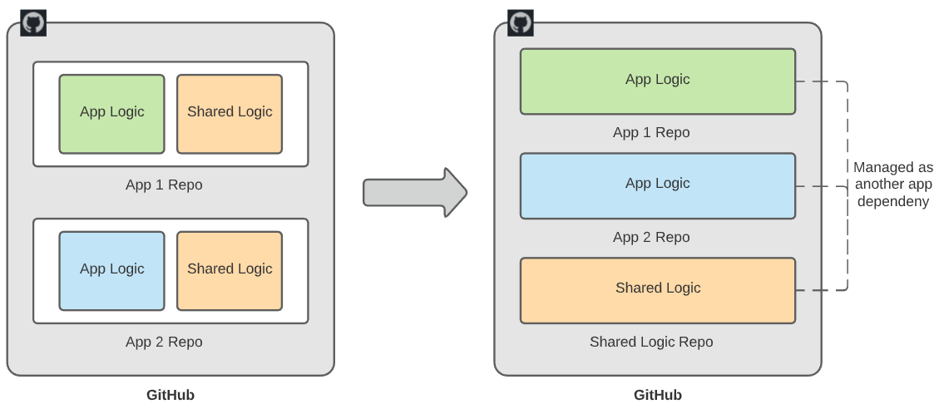
I. Codebase
One codebase tracked in revision control, many deploys
There is only one codebase but there can be multiple deployments across multiple environments (e.g., development, QA, staging, production)
Codebase is the same across all deployments, but environments may have different versions (code branches) and different configuration
Notes:
What are code repositories and why are they valuable?
Why is it better to factor shared code into its own repo rather than repeat the logic in several other repos?
What are some potential challenges with a shared code repository?

Slide 69
II. Dependencies
Explicitly declare and isolate dependencies
Depending on the platform, dependencies can be globally-defined or locally-defined (i.e., local to an application implementation)
The twelve-factor app explicitly declares all dependencies (name and version) locally using a dependency declaration manifest
The twelve-factor app also leverages dependency isolation to ensure local dependencies do not get overridden by a different scope

Slide 70
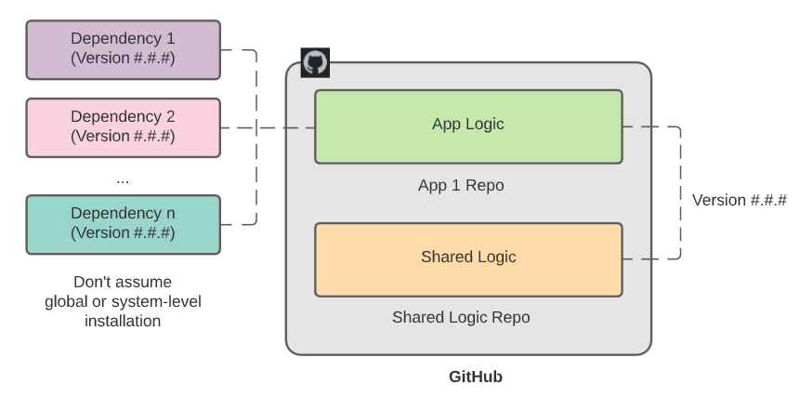
II. Dependencies
Explicitly declare and isolate dependencies
Does not rely on implicit existence of system tools – app is a complete bundle
Helps simplify onboarding of new developer (no assumptions required)
Notes:
If you’ve ever done any node.js development, you may be familiar with package.json. What are some benefits of calling out specific dependencies and specific versions in package.json?
What are some potential challenges with dependency versioning?

Slide 71
III. Config
Store config in the environment
Configuration data is usually settings that will vary from environment-to-environment (e.g., connection strings, target URL’s, etc.)
The twelve-factor app requires that this information be separate from the code (cannot use constants in the code to define)

Slide 72
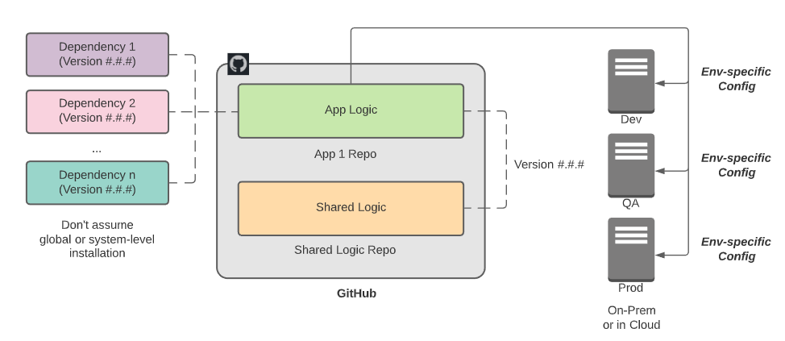
III. Config
Store config in the environment
The twelve-factor app stores this information in environment variables (variables / values specific to the target machine and its environment)
Helps to minimize “leakage” of sensitive configuration data either checked into the repo as code constants or config files

Slide 73
IV. Backing Services
Treat backing services as attached resources
A backing service is a service that the application consumes over the network or Internet (e.g., database, e-mail services, etc.)
These backing services are sometimes supported by third parties
The twelve-factor app does not make a distinction between local and third-party services – all are considered attached resources

Slide 74
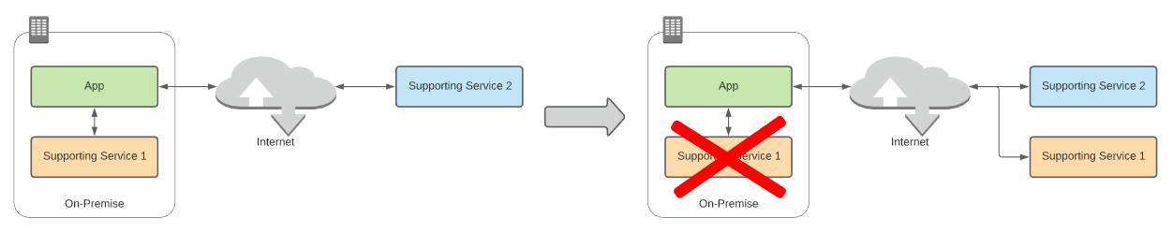
IV. Backing Services
Treat backing services as attached resources
By avoiding this distinction, the twelve-factor app can practice looser-coupling with its dependencies regardless of locality
Enables easier swapping between dependencies to ensure optimal target resource is employed

Slide 75
V. Build, Release, Run
Strictly separate build and run stages
The twelve-factor app uses strict separation between the build, release and run stages
Changes will not be made to the release or run stage independent from the build stage
Notes:
Build stage – converts code in code repo + dependencies into binary assets
Release stage – combines build output with environment-specific configuration
Run stage – runs the output from the release stage in a specific execution environment

Slide 76
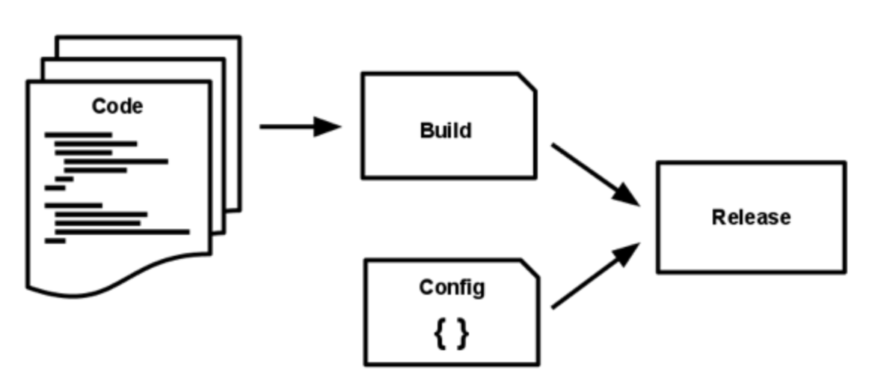
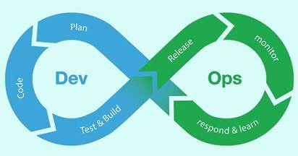
V. Build, Release, Run
Strictly separate build and run stages
Helps maintain an orderly (and repeatable) unidirectional flow through the stages
Also, allows for leverage of a unique identifier for each end-to-end flow through the stages for traceability and troubleshooting
Notes:
Build stage – converts code in code repo + dependencies into binary assets
Release stage – combines build output with environment-specific configuration
Run stage – runs the output from the release stage in a specific execution environment
The DevOps cycle is a good representation of this particular principle

Slide 77
VI. Processes
Execute the app as one or more stateless processes
The twelve-factor app does not rely on the sharing of state across processes through direct transfer of information
Instead, shared state is stored via a separate backing service external to a given process but accessible from multiple

Slide 78
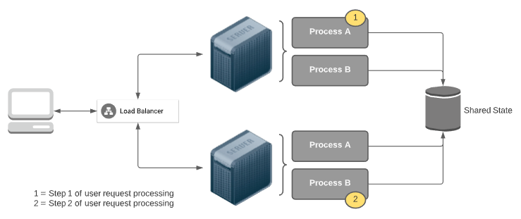
VI. Processes
Execute the app as one or more stateless processes
Otherwise, you create tight coupling between the processes that make up a complex system
Also, you limit scalability because shared state across processes requires “stickiness” for an end-to-end request (if not externally managed)
Notes:
Requires that each stage of a processed request always returns to the same server until complete
If a given workflow requires 2 steps – step 1 through process A and step 2 through process B – if state is not externally managed, then both steps will have to flow through the same server to enable access to the data needed to service the entire workflow. Difficult to scale out with more servers (to handle more concurrent requests) if “stickiness” required.

Slide 79
VII. Port Binding
Export services via port binding
Sometimes apps rely on a separate component or container for execution environment (e.g., web app relies on an external webserver container)
The twelve-factor app does not rely on runtime injection of an external container, but instead is completely self-contained

Slide 80
VII. Port Binding
Export services via port binding
Any required container will be captured within and exposed from the app environment via binding to a specific port (or ports) for runtime access
By keeping the application self-contained, you reduce coupling to other external components and minimize required assumptions about runtime environment
`docker run -it --rm -p 8000:5000 -e ASPNETCORE_URLS=http://+:5000 --name demo-container demo-image`

Slide 81
VIII. Concurrency
Scale out via the process model
Processes are a “first class citizen”
Allows an architect or developer to be intentional about what processes get created and how they are utilized to service a request
AKA horizontal scaling (vs. vertical scaling)

Slide 82
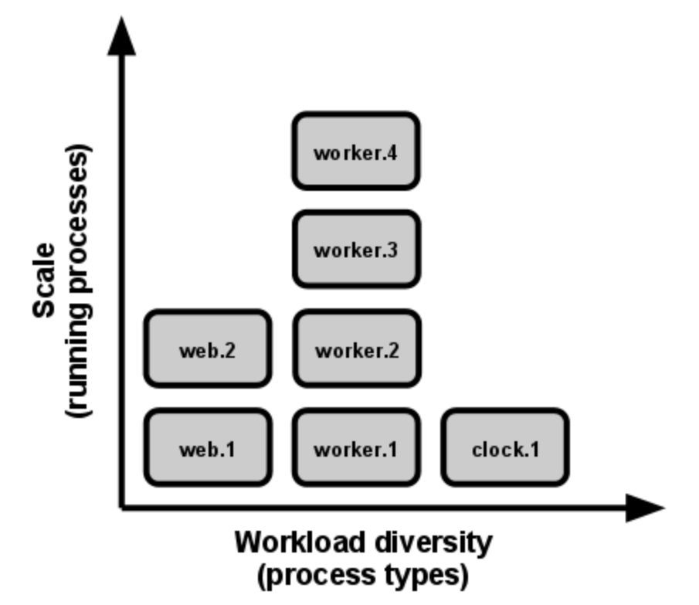
VIII. Concurrency
Scale out via the process model
Utilizes the underlying OS to manage the processes but the application maintains visibility
Enables concurrency – the ability to service multiple types of processing for a given workflow in parallel (scalability and performance)

Slide 83
IX. Disposability
Maximize robustness with fast startup and graceful shutdown
The twelve-factor app’s processes are disposable – they can be started or stopped as required and quickly (when required)
Enables elastic scalability – quick response to demand (up or down)
Processes should minimize startup time – whether for single instances or multiple instances of the process (redundancy)

Slide 84
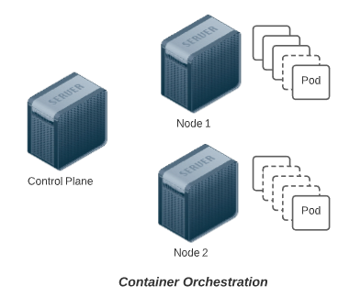
IX. Disposability
Maximize robustness with fast startup and graceful shutdown
Processes should be able to handle shutdown gracefully – since unneeded processes may need to be destroyed as demand decreases
Graceful shutdown should include the ability to handle crashes or error conditions

Slide 85
X. Dev / Prod Parity
Keep development, staging and production as similar as possible
The twelve-factor app is designed for continuous deployment – multiple pushes, sometimes multiple times a day, in response to ongoing code changes (agility)
This does not mean that each environment will have the same version or branch deployed

Slide 86
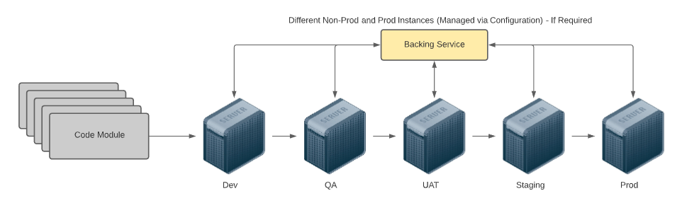
X. Dev / Prod Parity
Keep development, staging and production as similar as possible
However, modifications to the codebase should be unidirectional to ensure potential impact from change is sufficiently accounted for
Also, the twelve-factor app targets utilization of the same backing services regardless of environment, targeting variance in configuration alone
Notes:
The goal is minimal (ideally no) variance other than configuration between the environments

Slide 87
XI. Logs
Treat logs as event streams
Logs from the execution of an app should be streams of aggregated, time-order events collected as output from the running processes
The twelve-factor app incorporates routing of its corresponding output streams to a separate platform charged with log management (SRP)
The twelve-factor app relies on another process to aggregate, normalize and scrub the log data into usable information for end-to-end analysis
Key because there may be relevant logs for a transaction over-and-above the app itself – other components in addition to the app
Notes:
Web servers, network routes, etc.

Slide 88
XII. Admin Processes
Run admin / management tasks as one-off processes
Admin / management tasks are activities or instructions to be executed outside of the normal application flow (e.g., database migrations, administrative script execution)
The twelve-factor app treats these tasks as one-off process, ad hoc and separate from the main application (Separation of Concerns)
These one-off processes should be run in an identical environment against the same codebase and config
Should leverage the same dependencies (including versions) as are employed with the application itself – difference is in the workflow only
Notes:
Otherwise, if those admin functions need to be shipped with/exposed from the application to end users (by role), different tools/versions make deployment more complex and there are more potential points of failure (consistency is key)

Slide 89
Infrastructure-as-Code (IaC)

Slide 90


What is it?
The definition of the infrastructure (hardware & software) required to run your application in code (just like the application code)
Used in DevOps to automate the creation and recreation of supporting components
Multiple options available for implementation – AWS CloudFormation, Azure Resource Manager (ARM) templates, and Terraform (among others)
With IaC, key phrase to remember: “We treat our infrastructure like cattle, not pets”

Slide 91
Why use it?
Supports the DevOps principle of “automate everything”
Since the infrastructure definition is in code, you can unit test it (like application code)
You can check it into source control and track change history (like application code)
You can run (and rerun) the code in any environment and stand up an instance of the infrastructure that is consistent and stable (avoids “it runs fine on my machine”)

Slide 92
Terraform
While microservice components can be created manually in the Cloud, it’s not ideal
IaC (Infrastructure-as-Code) is a better alternative
Infrastructure code (like all other code) is code
Can be tested, versioned, put in source control, etc.
Multiple options available for tooling to support

Slide 93
What is Terraform?
A form of “infrastructure as code”
Declarative domain-specific language
What is declarative?
Used to describe idempotent resource configurations, typically in cloud infrastructure
According to Hashicorp:
Terraform enables you to safely and predictably create, change, and improve infrastructure. It is an open-source tool that codifies APIs into declarative configuration files that can be shared amongst team members, treated as code, edited, reviewed, and versioned

Slide 94
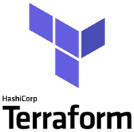
What is Terraform? (cont’d)
Open source CLI tool for infrastructure automation
Utilizes plugin architecture
Extensible to any environment, tool, or framework and works primarily by making API calls to those environments, tools, or frameworks
Detects implicit dependencies between resources and automatically creates a dependency graph
Builds in dependency order and automatically performs activities in parallel where possible
...Sequentially for dependent resources

Slide 95
Why Use Terraform?
Readable
Repeatable
Certainty (i.e., no confusion about what will happen)
Standardized environments
Provision quickly
Disaster recovery

Slide 96
What Does Terraform (HCL) Look Like?
resource “aws_instance” “web” {
ami = “ami-19827362728”
instance_type = “t2.micro”
tags = {
Name = “my-first-instance”
}
}

Slide 97
Hashicorp Configuration Language (HCL)
The goal of HCL is to build a structured configuration language that is both human and machine friendly for use with command-line tools, but specifically targeted towards DevOps tools, servers, etc.
Fully JSON compatible
Made up of stanzas or blocks, which roughly equate to JSON objects. Each stanza/block maps to an object type as defined by Terraform providers (we’ll talk more about providers later)
https://github.com/hashicorp/hcl

Slide 98
Terraform Project Content Types
*.tf, *.tf.json
HCL or JSON
these files define your declarative infrastructure and resources
*.tfstate
JSON files that store state, reference to resources
created and maintained by terraform
terraform.tfvars, terraform.tfvars.json and/or *.auto.tfvars, *.auto.tfvars.json
HCL or JSON
variable definitions in bulk
(more to come on setting variable values at runtime)

Slide 99
Resources
*.tf files contain your HCL declarative definitions
resource “aws_instance” “web” {
ami = “ami-19827362728”
instance_type = “t2.micro”
tags {
Name = “my-first-instance”
}
}
Most blocks in your HCL represent a resource to be created/maintained by Terraform

Slide 100
Resources
Resources are key elements and captured as top-level objects (stanzas) in Terraform configuration files
Each resource stanza indicates the intent to idempotently create that resource
Body of resource contains configuration of attributes of that resource
Each provider (e.g., AWS, Azure, etc.) provides its own set of resources and defines the configuration attributes
When a resource is created by Terraform, it’s tracked in Terraform state
Resources can refer to attributes of other resources, creating implicit dependencies
Dependencies trigger sequential creation

Slide 101
Terraform Commands and the CLI
The CLI is how you’ll most often use terraform
terraform init …
terraform plan …
terraform apply …
And plenty more: terraform --help or https://www.terraform.io/docs/commands/index.html
Third-party SDKs also available for running and interacting with Terraform (e.g., scalr, terragrunt, terratest)

Slide 102
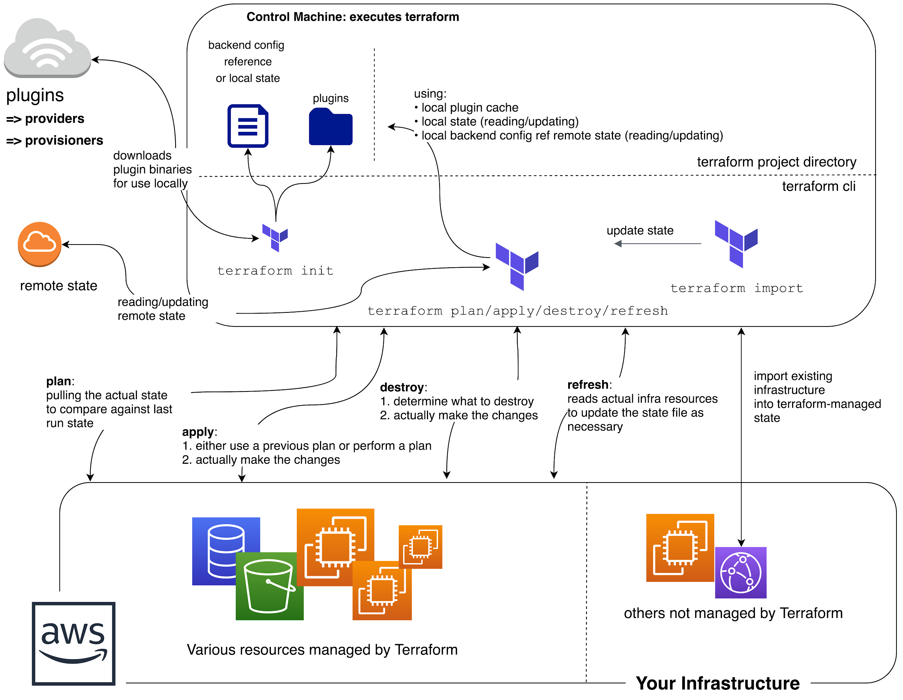
Big picture look at
Terraform Command Flow

Slide 103
terraform init
A special command, run before other commands/operations
What does it do?
Downloads required provider packages
Downloads modules referenced in the HCL (more on modules later)
Initializes state
Local state: ensuring local state file(s) exist
Remote state: more complex initialization (more on remote state later)
Basic syntax check
Idempotent
Uses a .terraform directory?
init downloads the provider packages and modules to this directory
Also, where state files live (locally)

Slide 104
Input Variables
Enable interchangeable values to be stored centrally and referenced single or multiple times
Similar to variables in other languages
Declared in variable stanzas
Parsed first
Cannot interpolate or reference other variables
Allow for default values
Optionally specify value type, e.g.,
List, Map, String

Slide 105
Input Variables
Input variable definitions support the following
default – provides default value if not specified; makes optional
type – type of value accepted for the variable
description – string description/documentation
validation – block for defining validation rules for input
sensitive – true or false; limits output as part of TF operations (plan or apply)

Slide 106
Example Variable Definition
variable “instance_size” {
default = “t2.micro”
type = string # changed in 0.12
description = “Size of EC2 instance”
}

Slide 107
Example Variable Definition
variable “student_alias” {
type = string
description = “Your student alias”
validation {
condition = trimprefix(var.student_alias, “test”) == var.student_alias
error_message = “Please do not use test aliases with this deployment.”
}
}

Slide 108
Data Sources
Logical references to data objects stored externally to the tfstate file
Allows you to reference resources not created by Terraform
Examples
current default region in AWS CLI
AMI ID search
AWS ARN lookup
AWS VPC CIDR range
Notes:
AMI = Amazon Machine Image
ARN = Amazon Resource Name
CIDR = Classless Internet Domain Routing

Slide 109
Data Source Example: AWS AMI Lookup
data "aws_ami" "latest-ubuntu" {
most_recent = true
owners = ["099720109477"]
filter {
name = "name"
values = ["ubuntu/images/hvm-ssd/ubuntu-xenial-16.04-amd64-server-*"]
}
filter {
name = "virtualization-type"
values = ["hvm"]
}
}
Notes:
HVM = hardware virtual machine (cf. xen)

Slide 110
Providing Values for Input Variables
Multiple options
Using environment variables (prefixed with “TF_VAR_”)
Defining inputs in a terraform.tfvars file
Defining inputs in a terraform.tfvars.json file
Defining inputs in one or more *.auto.tfvars files
Defining inputs in one or more *.auto.tfvars.json files
-var and -var-file options on the command-line

Slide 111
Providing Values for Input Variables
Environment Variables
Order Loaded
Precedence
terraform.tfvars File (if present)
Processed in lexical order of filenames
terraform.tfvars.json File (if present)
*.auto.tfvars File(s) (if present)
*.auto.tfvars.json File(s) (if present)
-var and -var-file Cmd Line Options
Processed in order provided on cmd

Slide 112
Providing Values for Input Variables
Primarily used when executing Terraform via CLI
Not really used with Terraform Enterprise
Can “push” those variables + values to Enterprise (in files)
But manage from “Variables” section of the environment

Slide 113
State
Stores information about resources that are created by Terraform
Also includes values computed by the provider APIs
Local file
.tfstate
Or backends are also available…

Slide 114
Backends
Determines how state is loaded and how operations like apply are executed
Enables non-local file state storage, remote execution, etc.
Why use a backend?
Can store their state remotely and protect it to prevent corruption
Some backends, e.g., Terraform Cloud automatically store all revisions
Keep sensitive information off local disk
Remote operations
Apply can take a LONG time for large infrastructures
Notes:
Swift = objecy/blob store

Slide 115
Backends (cont’d)
Examples
S3
swift
http
Terraform Enterprise
etc.
Notes:
Swift = objecy/blob store

Slide 116
Providers
Responsible for understanding API interactions and exposing resources
Hashicorp helps companies create providers to be added to ecosystem
Declared in HCL config files as a provider stanza
Each Terraform project can have multiple providers, even of the same type
Describes resources, their inputs, outputs, and the logic to create and change them
Many options
AWS, GCP, Azure, and many many others
providers available for non-infra services as well such as gmail, MySQL, and Pagerduty

Slide 117
The AWS Provider
Provider documentation
https://www.terraform.io/docs/providers/aws/index.html
HUGE amount of resources
Something like 8 resources per service on average

Slide 118
Configuring the Provider
provider “aws” {
region = “us-west-1”
access_key = “[your access key]”
secret_key = “[your secret access key]”
}

Slide 119
Output Variables
inputs to a Terraform config are declared with variables stanzas
outputs are declared with a special output stanza
Can be referenced through the modules interface or the CLI

Slide 120
Output Variables
Output variable definitions support the following
value – value to be returned as output
description – string description/documentation
sensitive – true or false; limits output as part of TF operations (plan or apply)

Slide 121
Output Definition
output “instance_public_ip” {
value = aws_instance.web.public_ip
}

Slide 122
Demo
https://github.com/ludesdeveloper/terraform-lambda-golang

Slide 123




Thank you!
If you have additional questions, please reach out to me at:
(email address)

